Slide 1

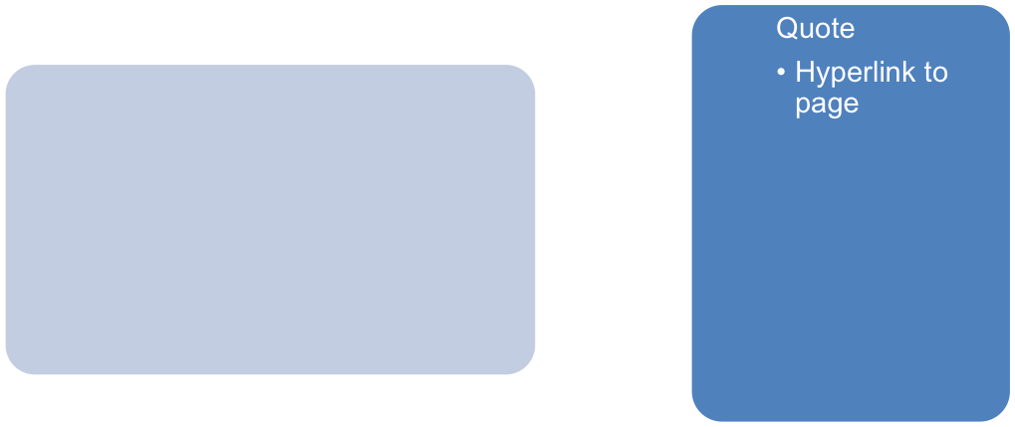
Global Health Film Festival
….the Right to Heal
LOGO
Date/Location/FREE!
*Hyperlinks to appropriate pages
Have maybe 3 images that scroll with associated quotes & hyper links

Slide 2
About
-Why
Image
Text…….(with hyperlink)
Image
Text…….(with hyperlink)
Image
Text…….(with hyperlink)

Slide 3
About
-Who we Are
Image
Text…….(with hyperlink)
Image
Text…….(with hyperlink)
Image
Text…….(with hyperlink)

Slide 4
About
-Festival Schedule
-Schedule outline (at this point just text, may add images and have similar template to “Who we Are Page”)
-Google Map/Calendar/Outlook links
-Maybe Event Brite link? Embedded into the page?
-Open to thoughts?

Slide 5
Submit a Film
-Will need to have instructions (text)
-Ability to upload a document or read and verify or release liability
-Ability to upload the film (maybe to a Box.net account or email, the films will probably be big files so we will need your help with this one? On how to handle it.

Slide 6
Partners
Image
Text…….(with hyperlink)
Image
Text…….(with hyperlink)
Image
Text…….(with hyperlink)

Slide 7
Join Us
FaceBook
Twitter
Pintrest?
Instragram
Email list sign up? (Contact Form that will feed into a database-could be google survey?)
Volunteer sign up? (Contact Form that will feed into a database-could be google survey?)

